Slide 1


Python Session 20

Slide 2
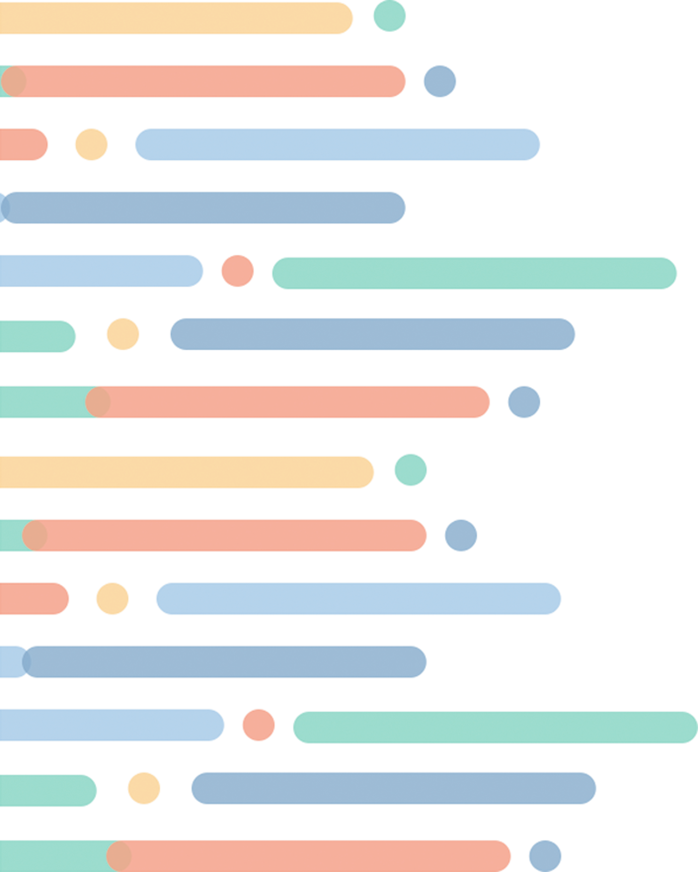

Today
Structuri de Date
BigO Notation
IT School ©2022 Proprietary and Confidential. All Rights Reserved.

Slide 3
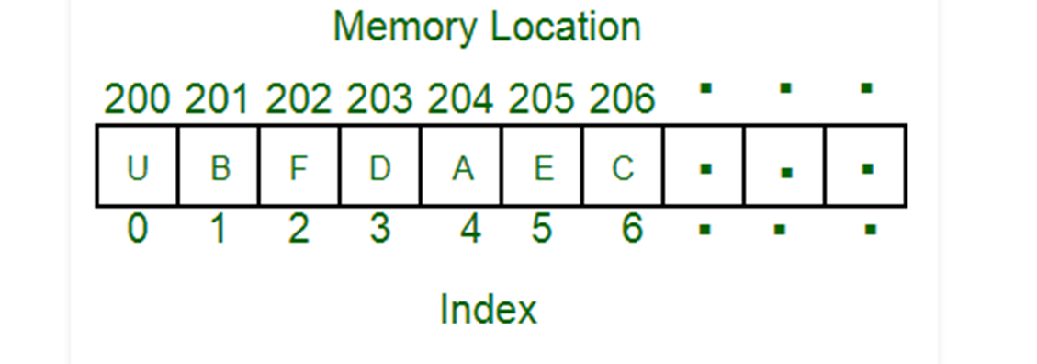
Structuri de date
•O structură de date este un mod prin care putem organiza date pentru a putea fi folosite efficient
•De exemplu, putem inmagazina o lista de obiecte avand folosind o structure array
IT School ©2022 Proprietary and Confidential. All Rights Reserved.

Slide 4
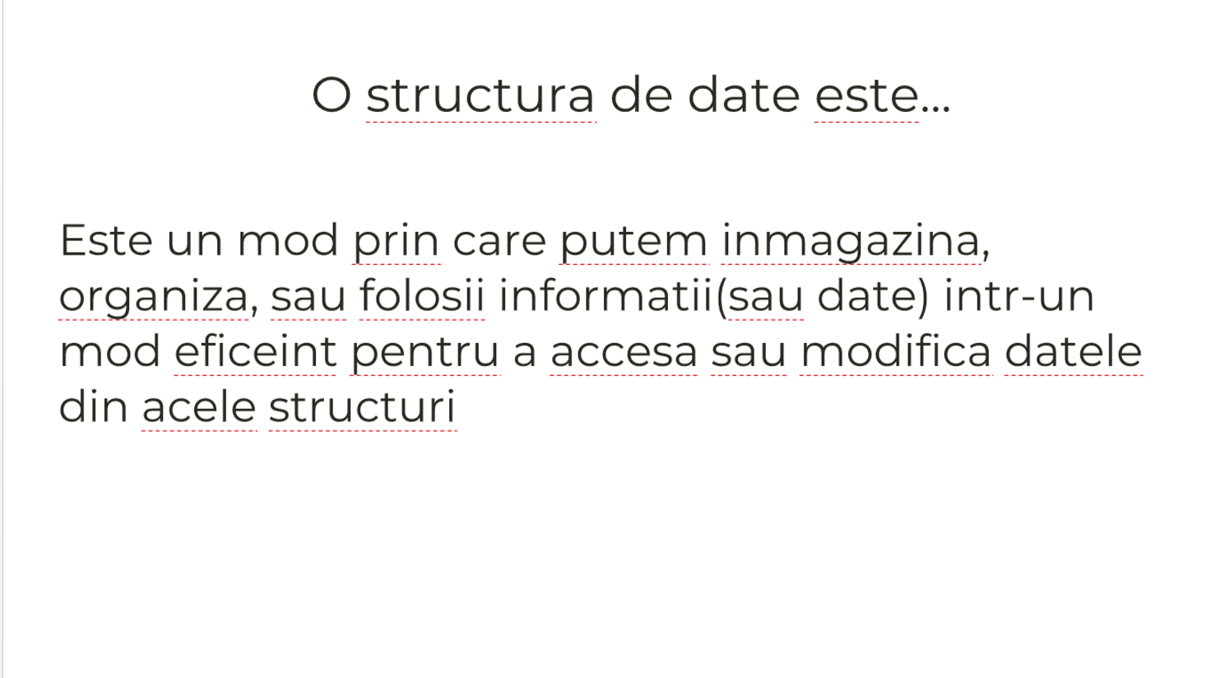
Structuri de date
IT School ©2022 Proprietary and Confidential. All Rights Reserved.

Slide 5
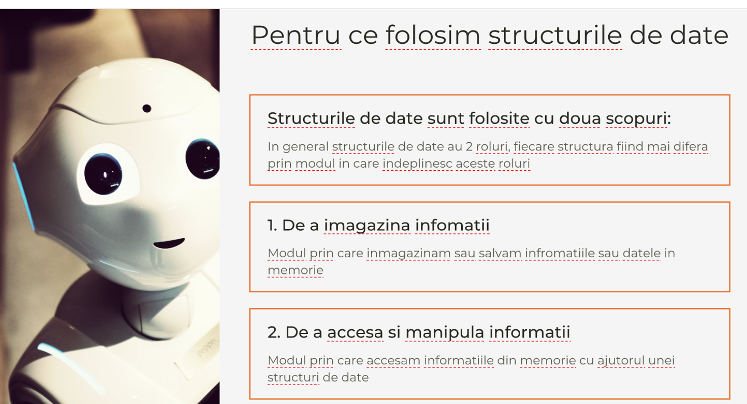
Structuri de date
IT School ©2022 Proprietary and Confidential. All Rights Reserved.

Slide 6
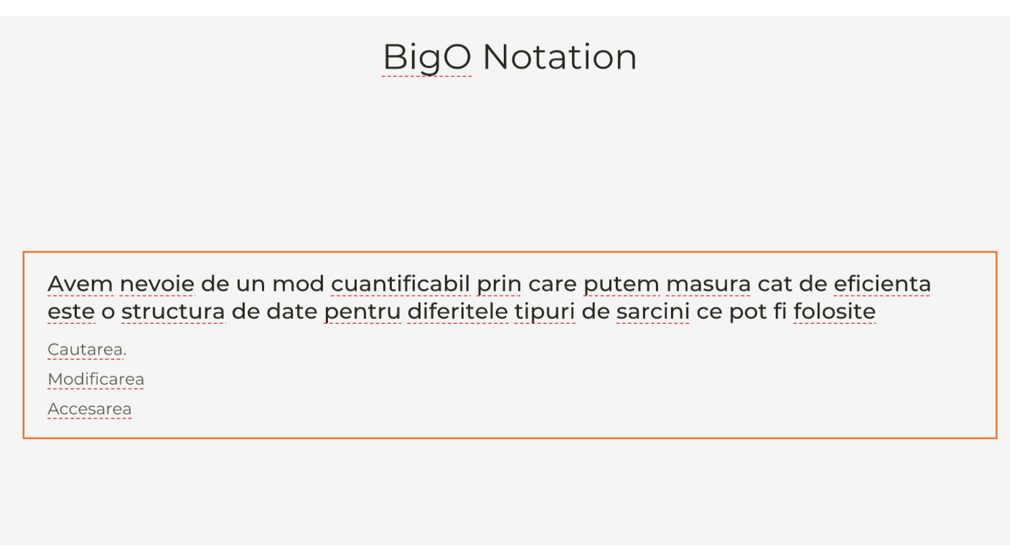
Structuri de date:
IT School ©2022 Proprietary and Confidential. All Rights Reserved.

Slide 7
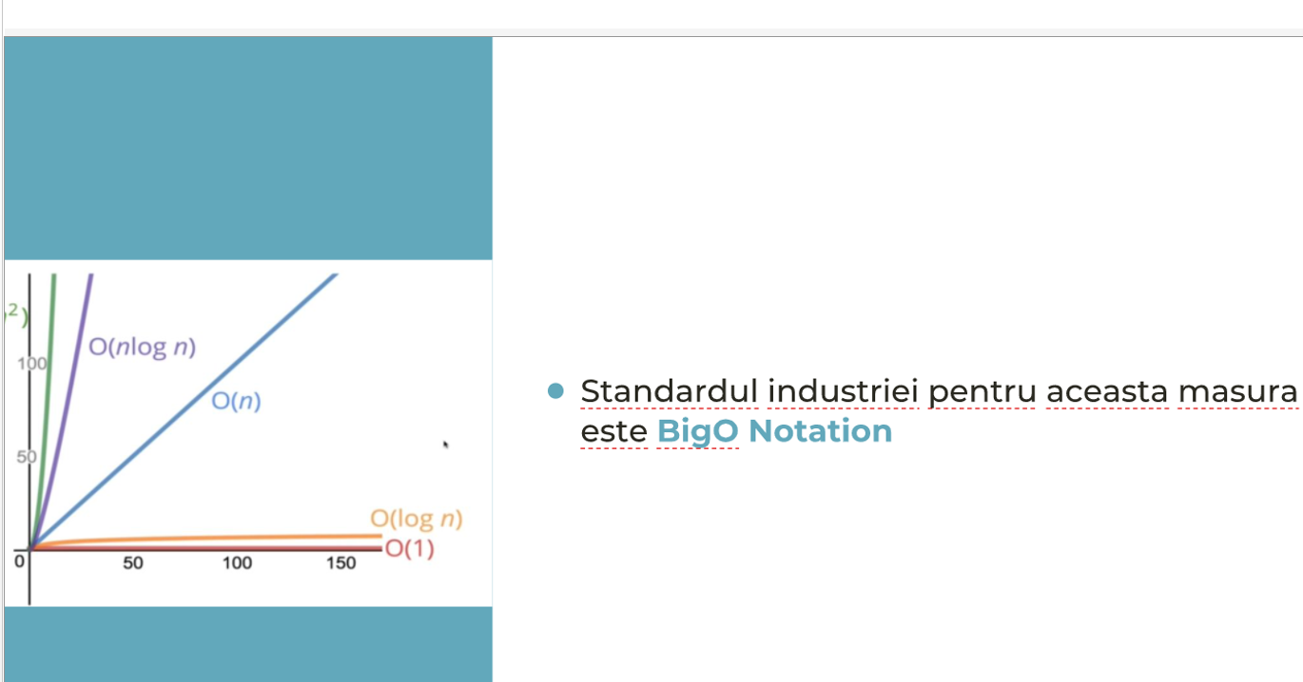
ÎBigO Notation
IT School ©2022 Proprietary and Confidential. All Rights Reserved.

Slide 8
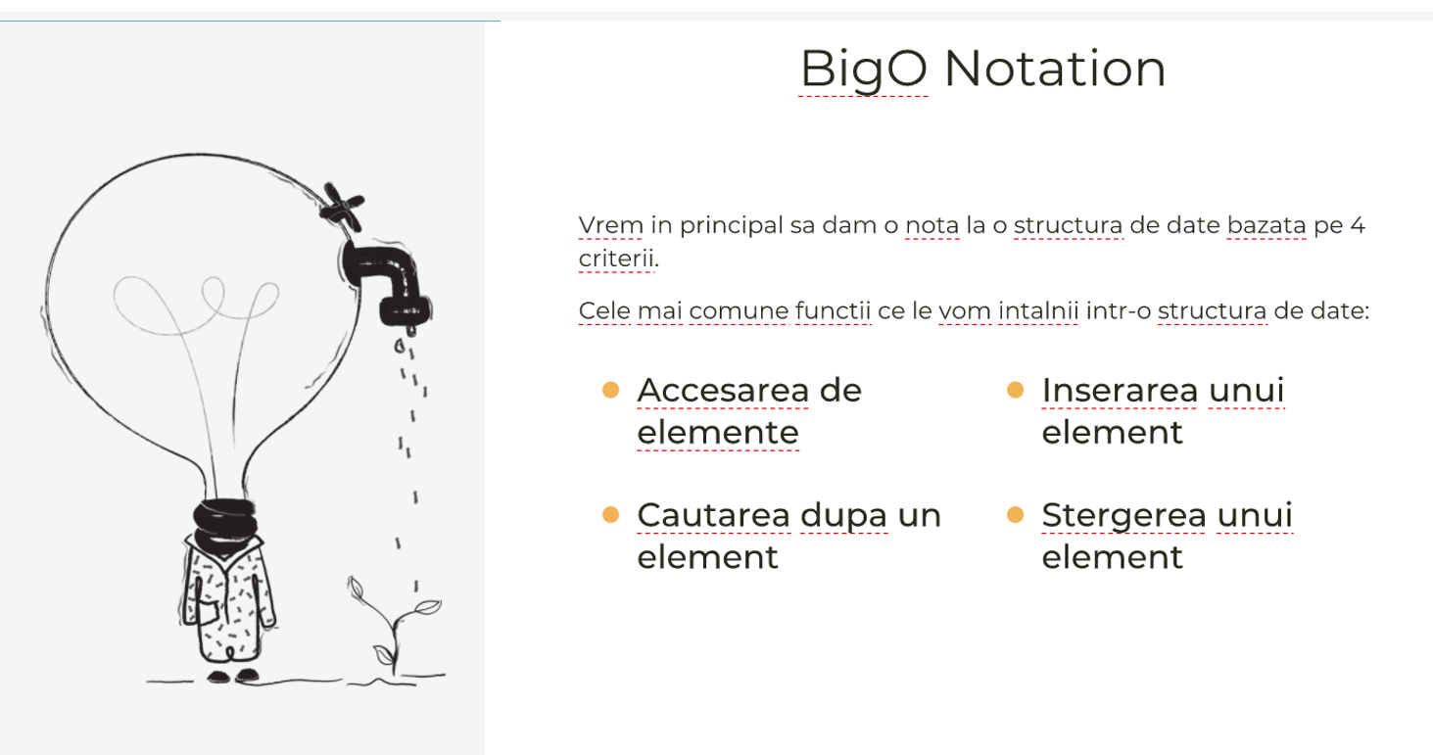
BigO Notation
IT School ©2022 Proprietary and Confidential. All Rights Reserved.

Slide 9
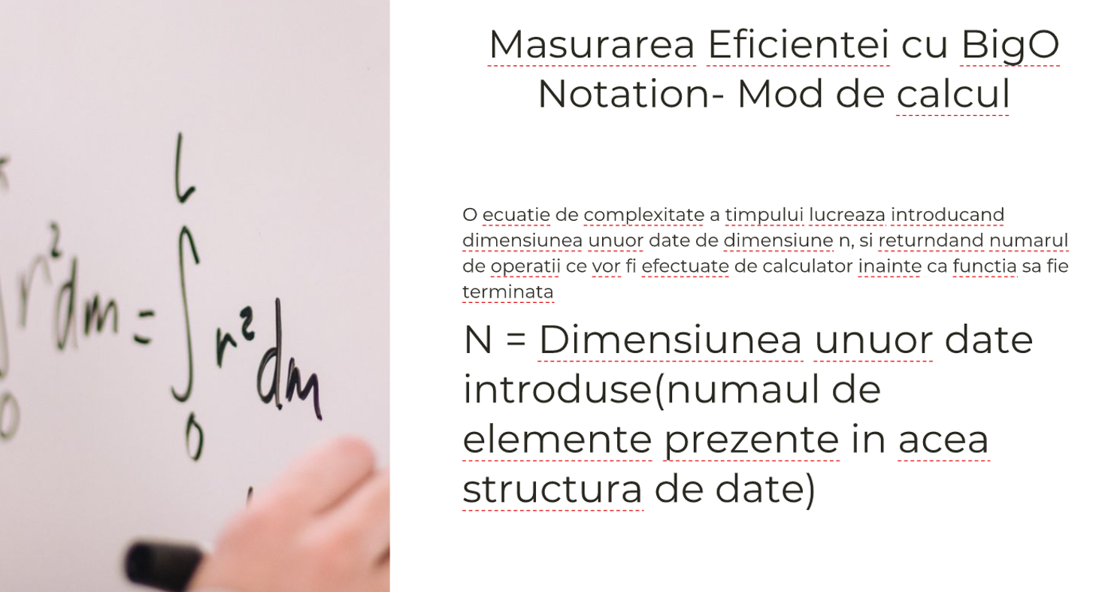
BigO Notation
IT School ©2022 Proprietary and Confidential. All Rights Reserved.

Slide 10
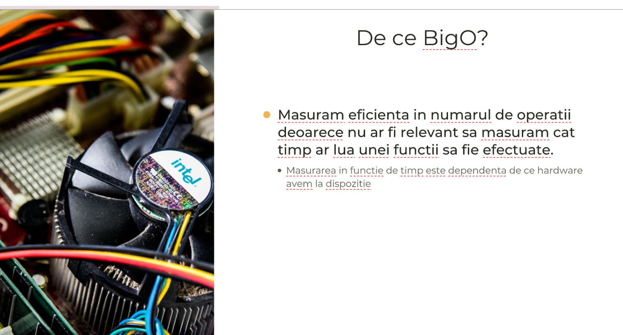
BigO Notation
IT School ©2022 Proprietary and Confidential. All Rights Reserved.

Slide 11
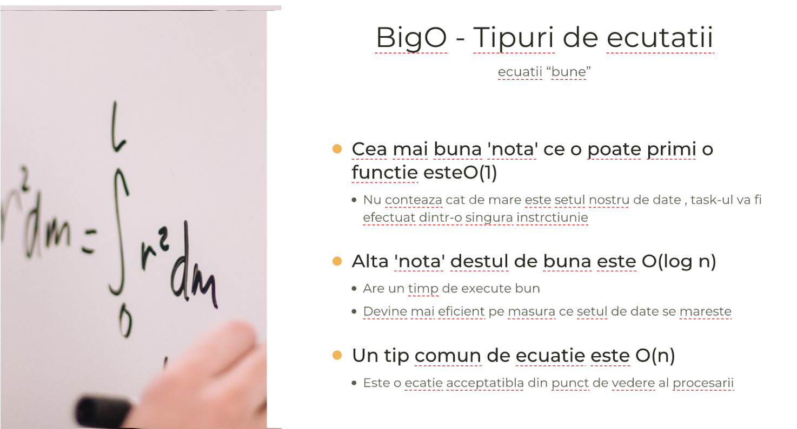
BigO Notation
IT School ©2022 Proprietary and Confidential. All Rights Reserved.

Slide 12
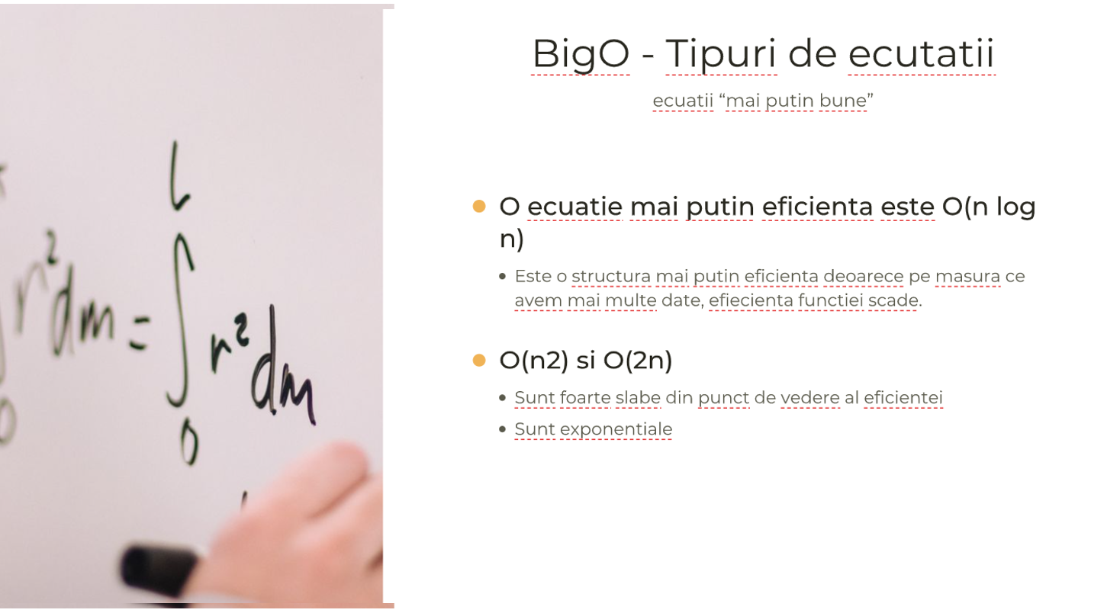
BigO Notation
IT School ©2022 Proprietary and Confidential. All Rights Reserved.

Slide 13
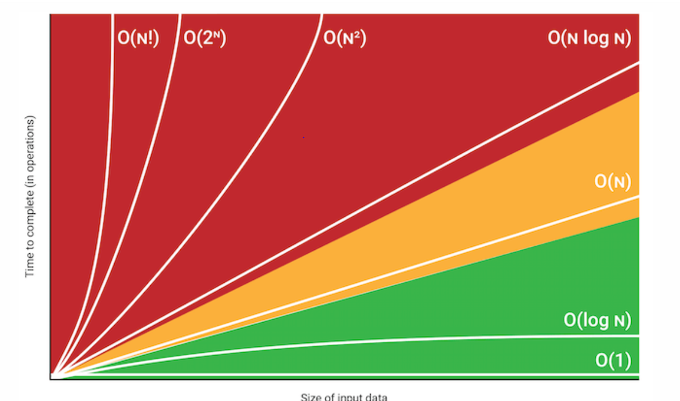
BigO Notation
IT School ©2022 Proprietary and Confidential. All Rights Reserved.

